Slide 1

Guiding Dynamic Motion Planning with Low-Dimensional PRM
Thorn Prescott & Shyam Rajendren
Le, D., & Plaku, E. (2014, September). Guiding sampling-based tree search for motion planning with dynamics via probabilistic roadmap abstractions. In 2014 IEEE/RSJ International Conference on Intelligent Robots and Systems (pp. 212-217). IEEE

Slide 2
Introduction
Robot Dynamics constrain motion
Dynamics Equations
High Dimensional
Nonlinear
Solutions
Workspace Decomposition
Sample-Based Planning
Paper uses PRM on Simplified Environment

Slide 3
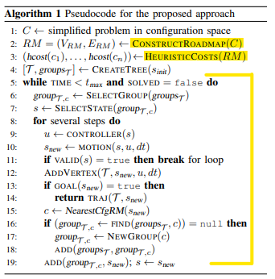
Method Overview
Highlighted:
Roadmap Abstraction
Heuristic Costs
Guiding Expansion
C: Simplified Configuration Space
S: Actual Configuration Space

Slide 4
Roadmap Abstraction
Configuration Space C
Low-Dimensional
Related to S
Construct Roadmap in C with PRM
Sampling to create Vertices and Edges
Nearest Neighbors and Distance Metric
Additional Sampling as needed

Slide 5

Heuristic Cost Generation
Heuristic Used
Shortest Path from Goal to $c$ ($c∈V_{RM}$)
Dijkstra’s Starting at Goal

Slide 6

Guiding Expansion
Tree built starting at $s_{init}$
$cfg(s)$ function S → C
Each $s$ is in a group based on nearest $c$
Iteration
Select a Group
Create Trajectory to point in Group

Slide 7
Guiding Expansion: Selecting Tree Group
Weight given to group
Heuristic
Frequency Group has been Selected
Maximum weighted group selected

Slide 8

Guiding Expansion: Expanding Tree Group
Sample Target Configuration
0.85 Near Roadmap
0.15 From entire C
Select closest $s$ to Target from Group
Trajectory to $s$ made via control inputs
Stop at Collision or step limit
Points along Trajectory added to Tree

Slide 9
Experiments and Results
Experiments were done using three models
Physics-based vehicle model
High-dimensional snake-like model
Aerial-vehicle model

Slide 10
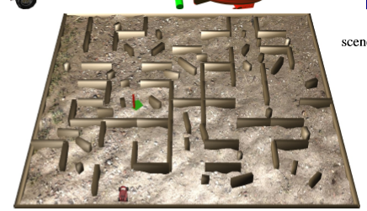
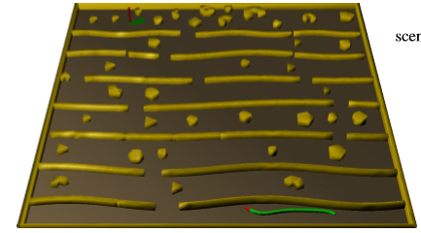
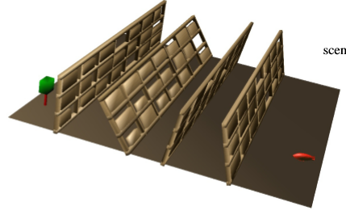
Physics-based vehicle model
High-dimensional snake-like model
Aerial-vehicle model

Slide 11
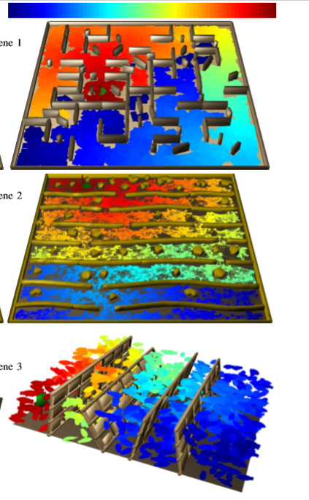
Color represents distance from goal. Blue means you are far away from the goal. Red means you are closer to the goal.

Slide 12
Roadmap Abstractions used in the Experiments
The number of initial samples is set to n = 10000 and the number of neighbors is set to k = 10
An additional 5000 samples are added to the roadmap if the initial roadmap configuration does not find a path between start and goal

Slide 13
Methods used in the Comparisons
The approach used while using roadmaps is referred to as P[prm]
The approach used while using workspace decompositions is referred to as P[ws]
The methods used for comparison are RRT, fRRT, PDST, IST, KPIECE

Slide 14
Problem Instances
Each model was tested on sixty different runs
The best five and worst five runs are removed from the result average
For the vehicle model, runs are produced by putting the car and goal at random positions
For the other two models, the robot is placed at one end of the scene while the goal is placed at random at the other end of the scene
Run time is the time between accepting an input to when a solution is found
Results are provided along with their standard deviation

Slide 15
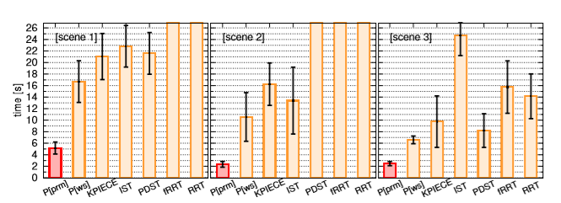
Results

Slide 16
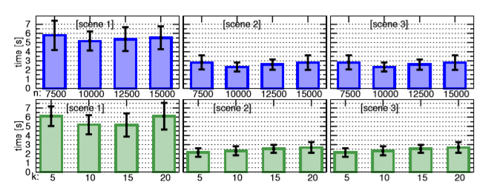
Results
Results when varying the number of roadmap configurations and nearest neighbors

Slide 17
Reasons for Improvement
The roadmap abstractions more effectively guide the motion-tree expansions as the roadmap uses a geometric shape that more closely relates to the full robot model as opposed to just using a point
The roadmap samples and edge connections help identify collision-free regions from which the tree search can be expanded
As a result, the roadmap abstractions provide the planner with more reliable suggestions of how to effectively reach the goal

Slide 18
Conclusion
Experimental results show that the proposed algorithm is significantly faster than existing popular algorithms
Results show a significant speedup when using roadmap abstractions when compared to using workspace decompositions

